Slide 1


The platform for building
strong communities and a better world

Slide 2




Governmental leaders, businesses and organizations face
critical challenges that require new ways to work together
  Climate Change
  Pollution
  Global pandemics
  Race relations
  Political divisions
  Refugees
  Terrorism
  Obesity & health
  Economic growth
  Workforce development
  War

Slide 3

Online social media platforms
aren’t the answer …
and are part of the problem
Important messages lost ‘shouting in the crowd’
Algorithms amplify negative messages
Increasing divisions instead of healing them
Major networks tolerate disinformation, hate speech and questionable
sources
Design-to-addict hurts people
Individual-centered instead of organizational mission-focus

Slide 4
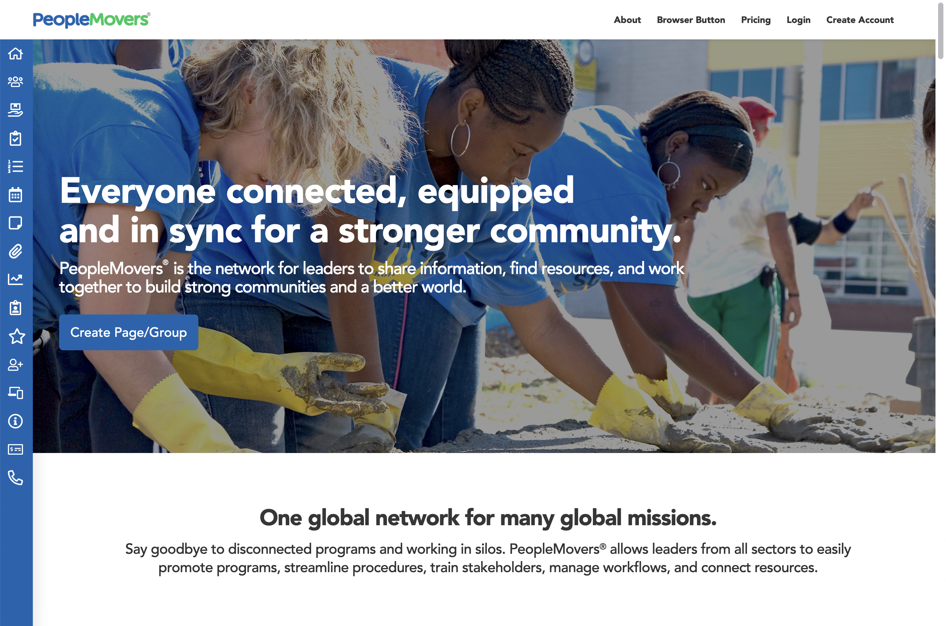
Enter PeopleMovers®: Syncing people, power, and purpose.
  PeopleMovers® is the global network and operating system for leaders to share knowledge, mobilize resources, and move initiatives forward — together.
  Built for collaboration – A full operating system designed for community and global development.
  Verified people and organizations – Building trust, transparency, and real partnerships.
  One powerful platform – Organize efforts, track progress, and measure real-world impact.

Slide 5

A multi-sided network for collaboration and amplifying messages
Federal, State & Local Governments
Associations &
Chambers of Commerce
Multi-laterals, Coalitions & Initiatives
Nonprofits & Foundations
Corporations & Small Businesses
Schools & Universities
Houses of Worship
Members, Employees & Citizens

Slide 6
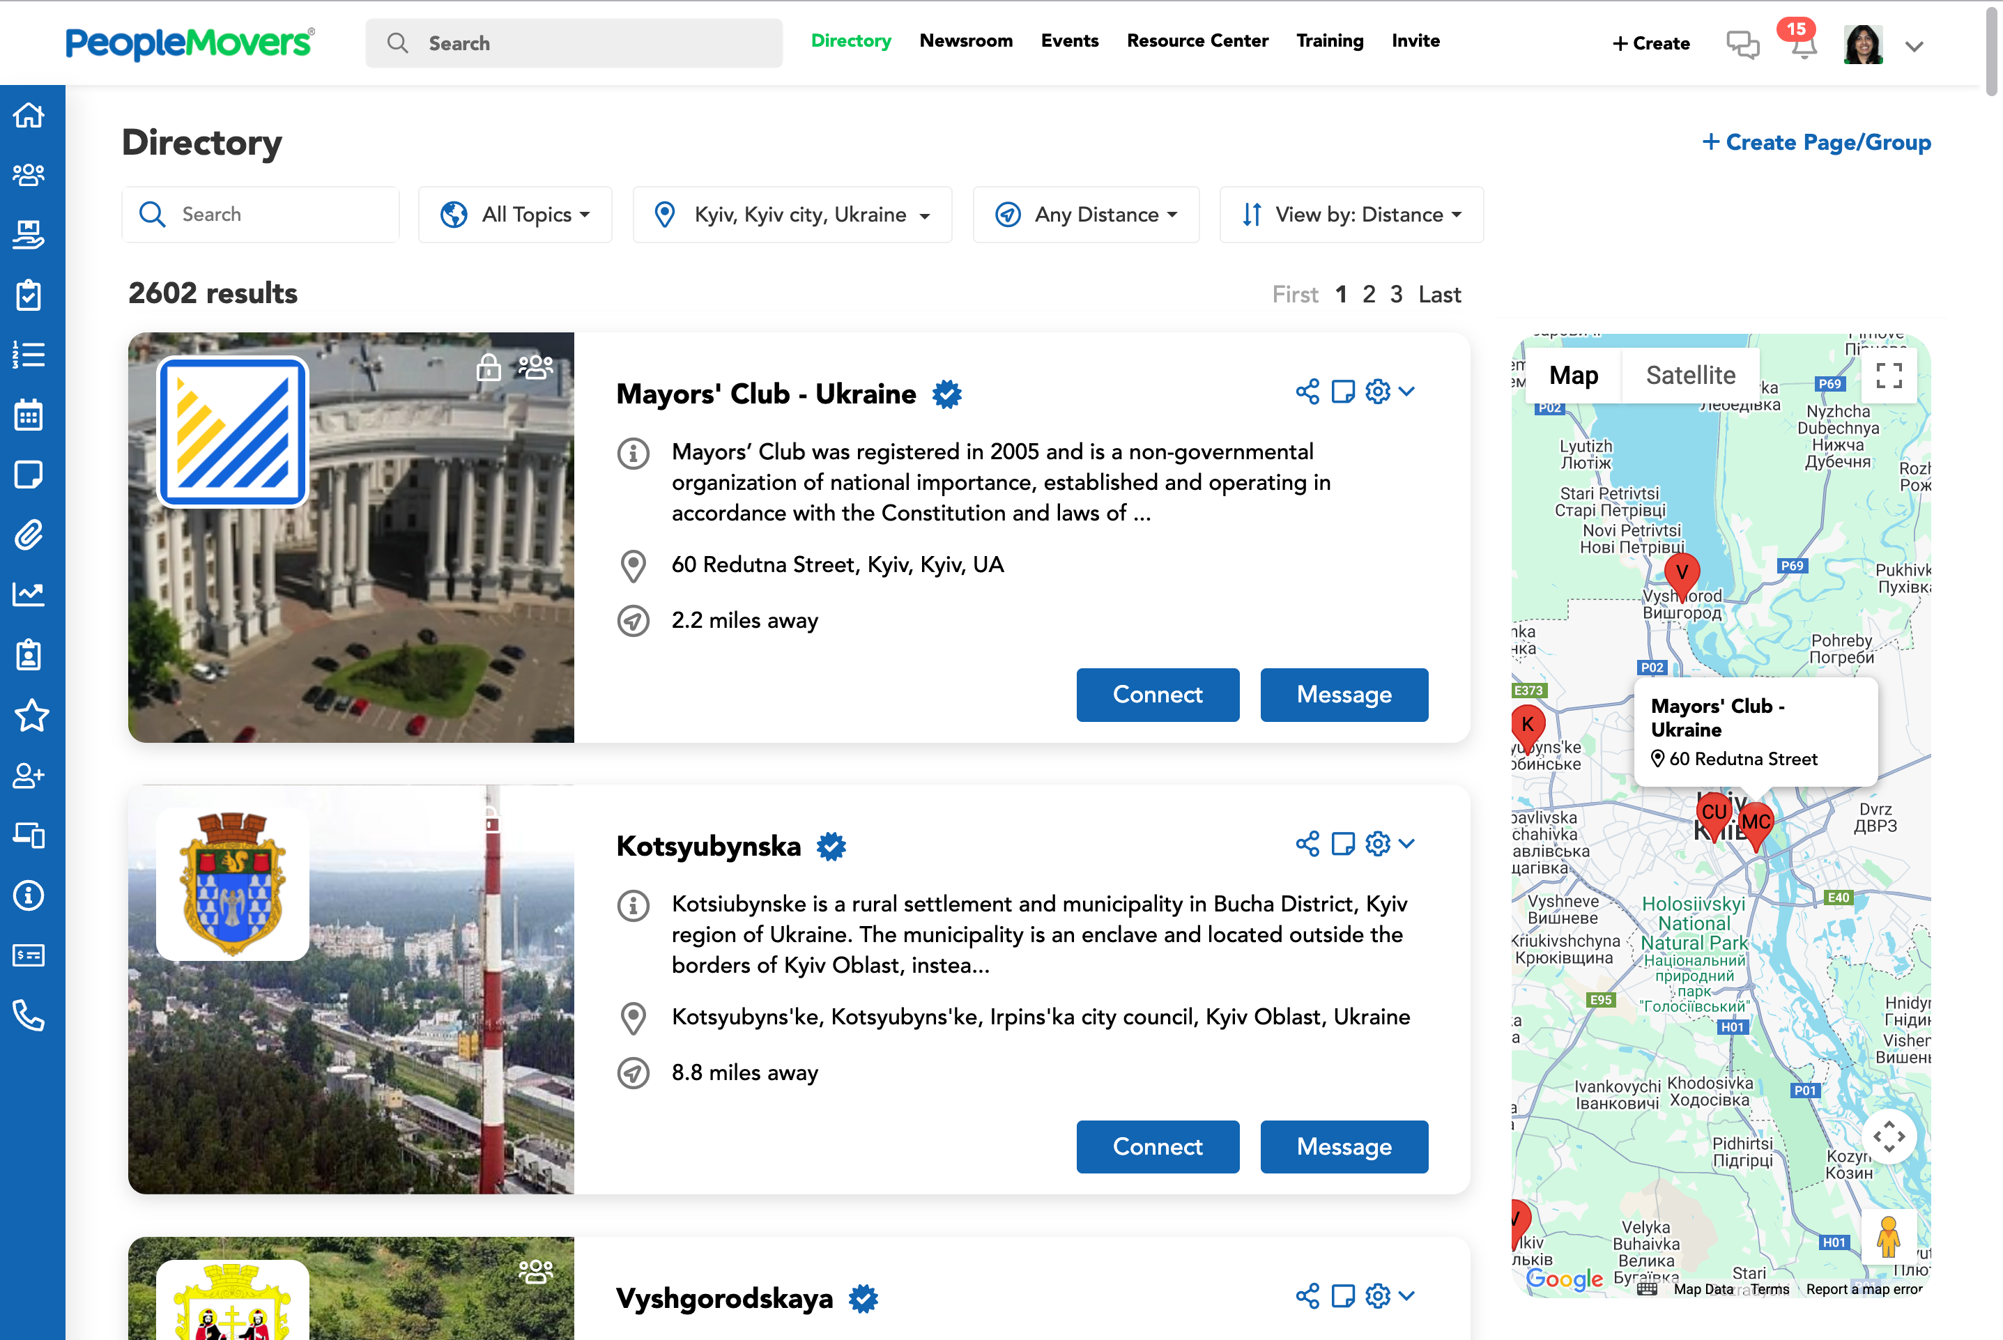
Build your global network with the PeopleMovers® Directory
  At PeopleMovers®, we’re building a directory of changemakers, a place to work together with people and organizations that are moving our world forward.
  Connect with leaders, agencies, companies, nonprofits, and schools who are driving real change.
  Find partners, collaborators, and supporters ready to share knowledge and solve real-world challenges.
  Grow your reach, visibility, and impact — locally and globally.

Slide 7
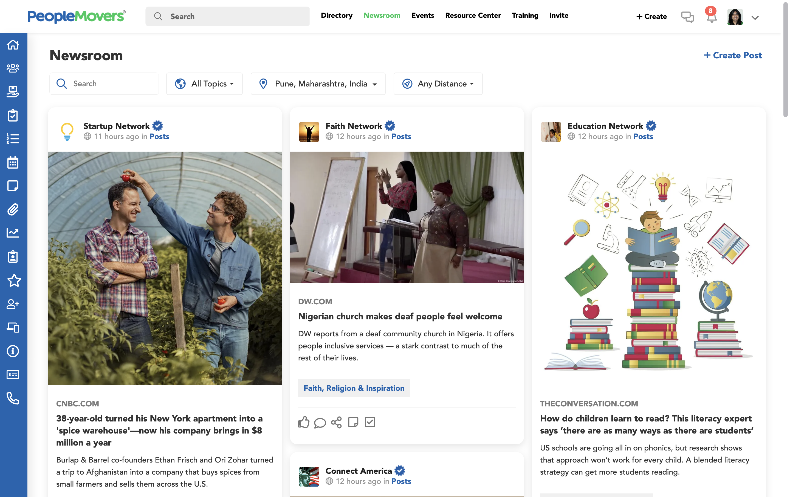
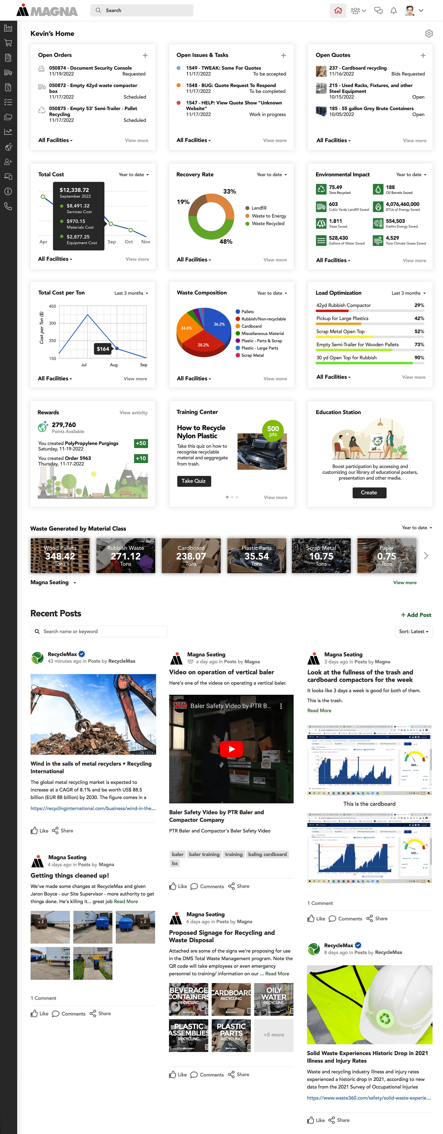
Publish news, information and events in the Newsroom
  The PeopleMovers® Newsroom gives leaders a direct way to share important updates without the noise of traditional social media.
  Publish official news, initiatives, and event updates to a trusted global audience.
  Cut through the clutter — reach the right people without relying on email blasts or crowded social platforms.
  Only verified organizations can post publicly, ensuring credibility and trust.

Slide 8
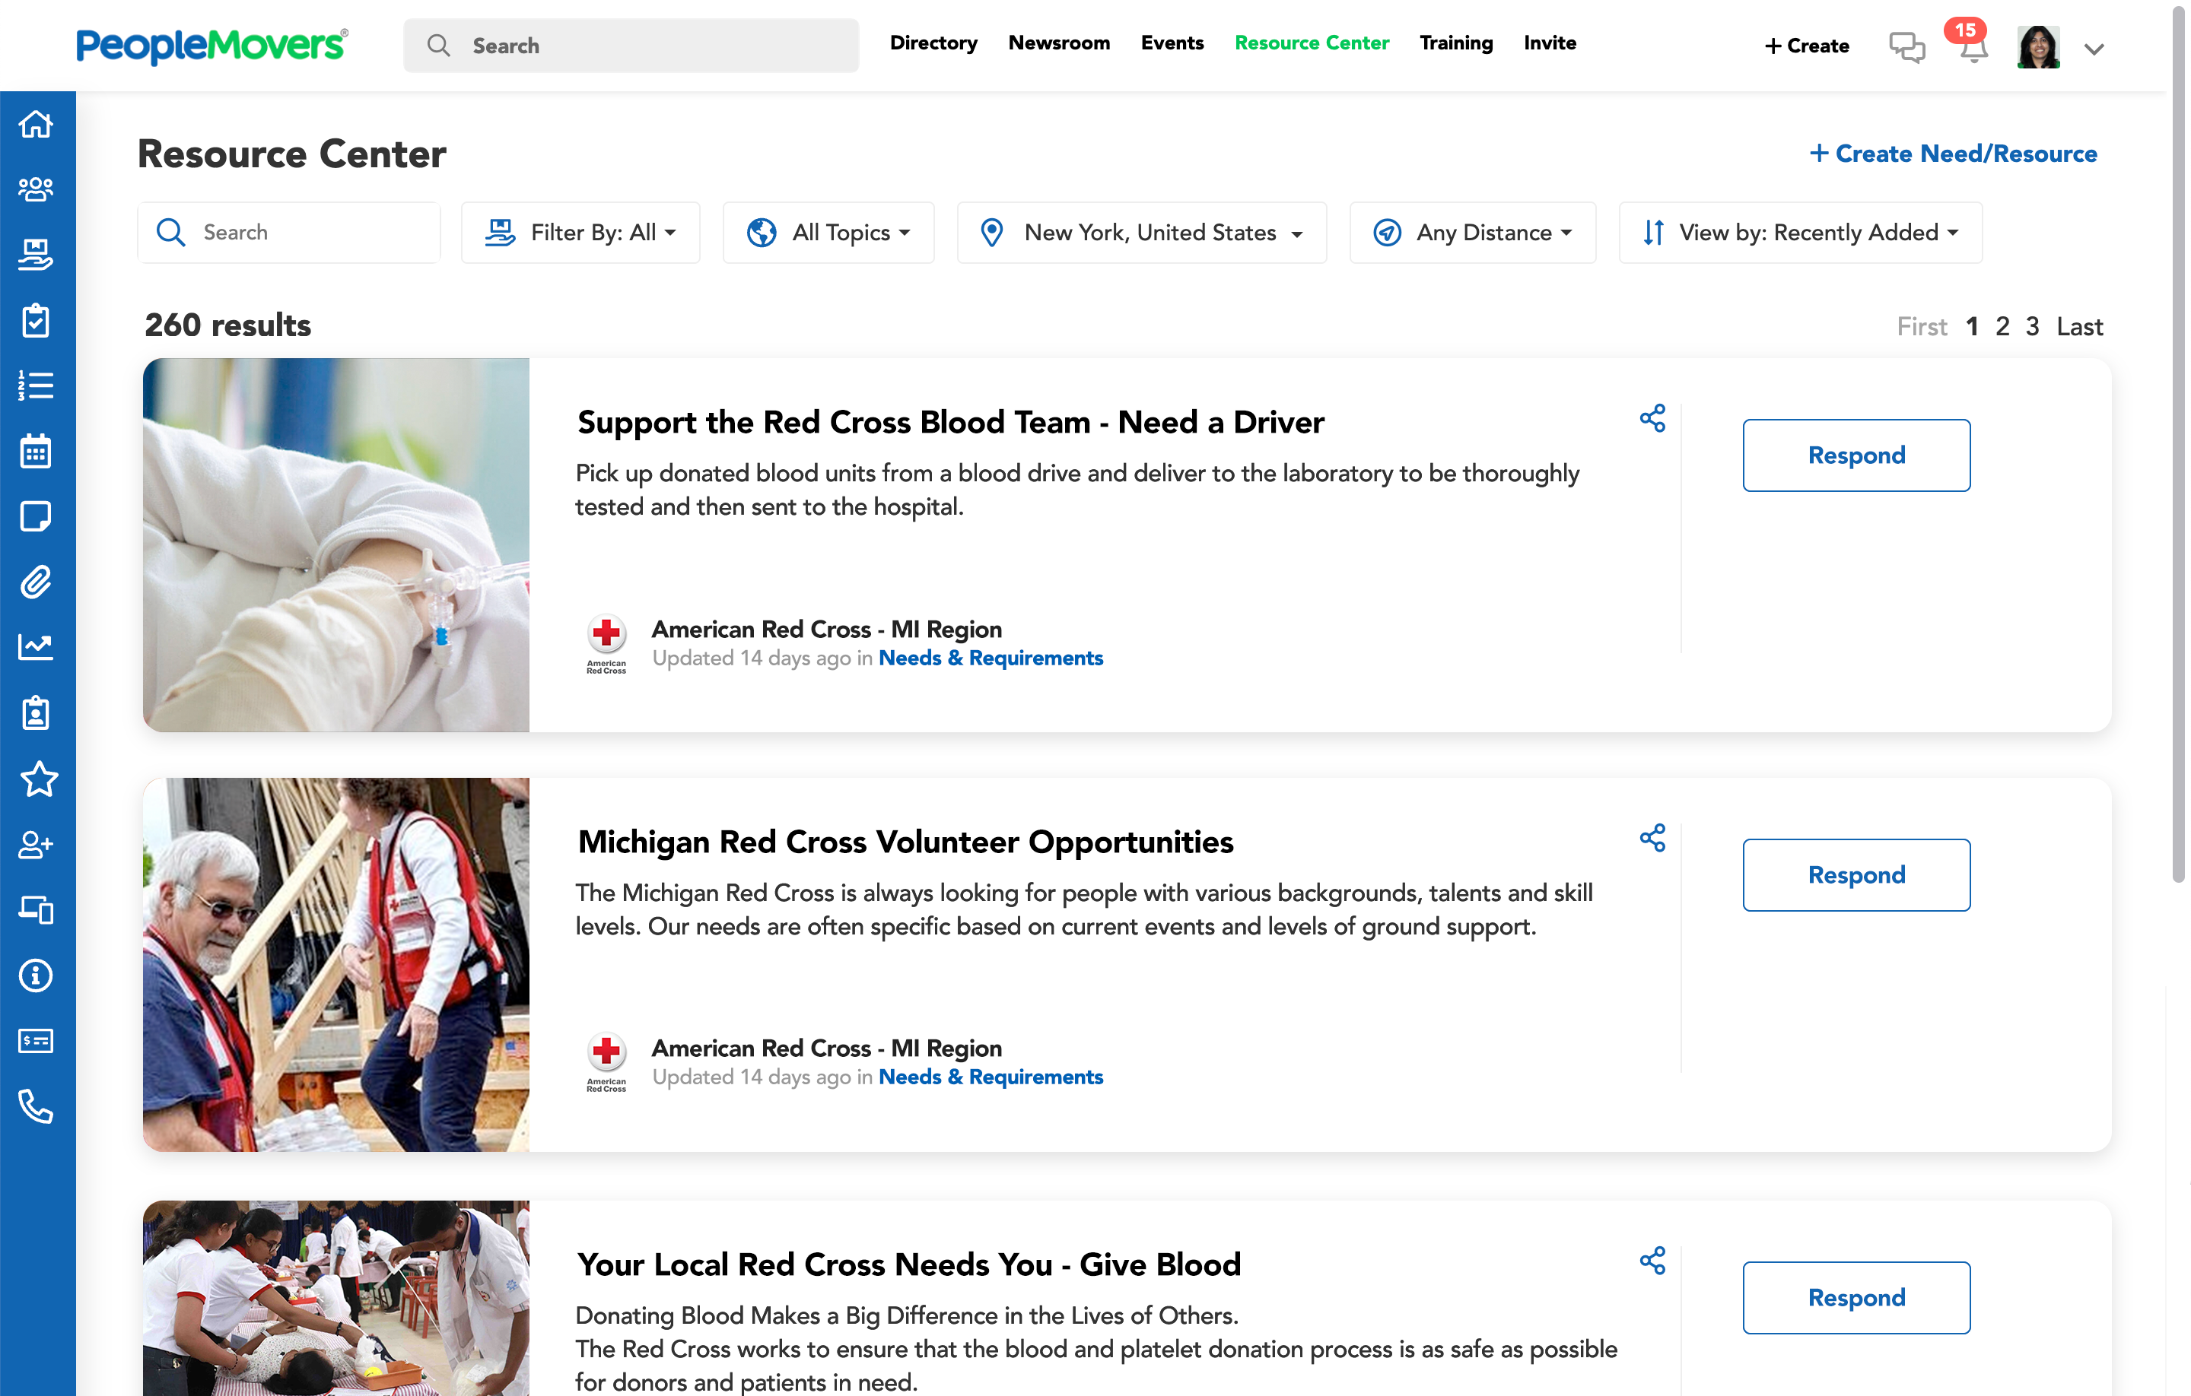
Connect with global resources in our Resource Center
  The Resource Center connects projects with the people and supplies they need to succeed.
  Post a Need – Request support for a project, service, or product.
  Offer a Resource – Share your skills, supplies, or services to help others.
  Get Matched – Connect with a global network of leaders, agencies, nonprofits, and companies ready to help.

Slide 9
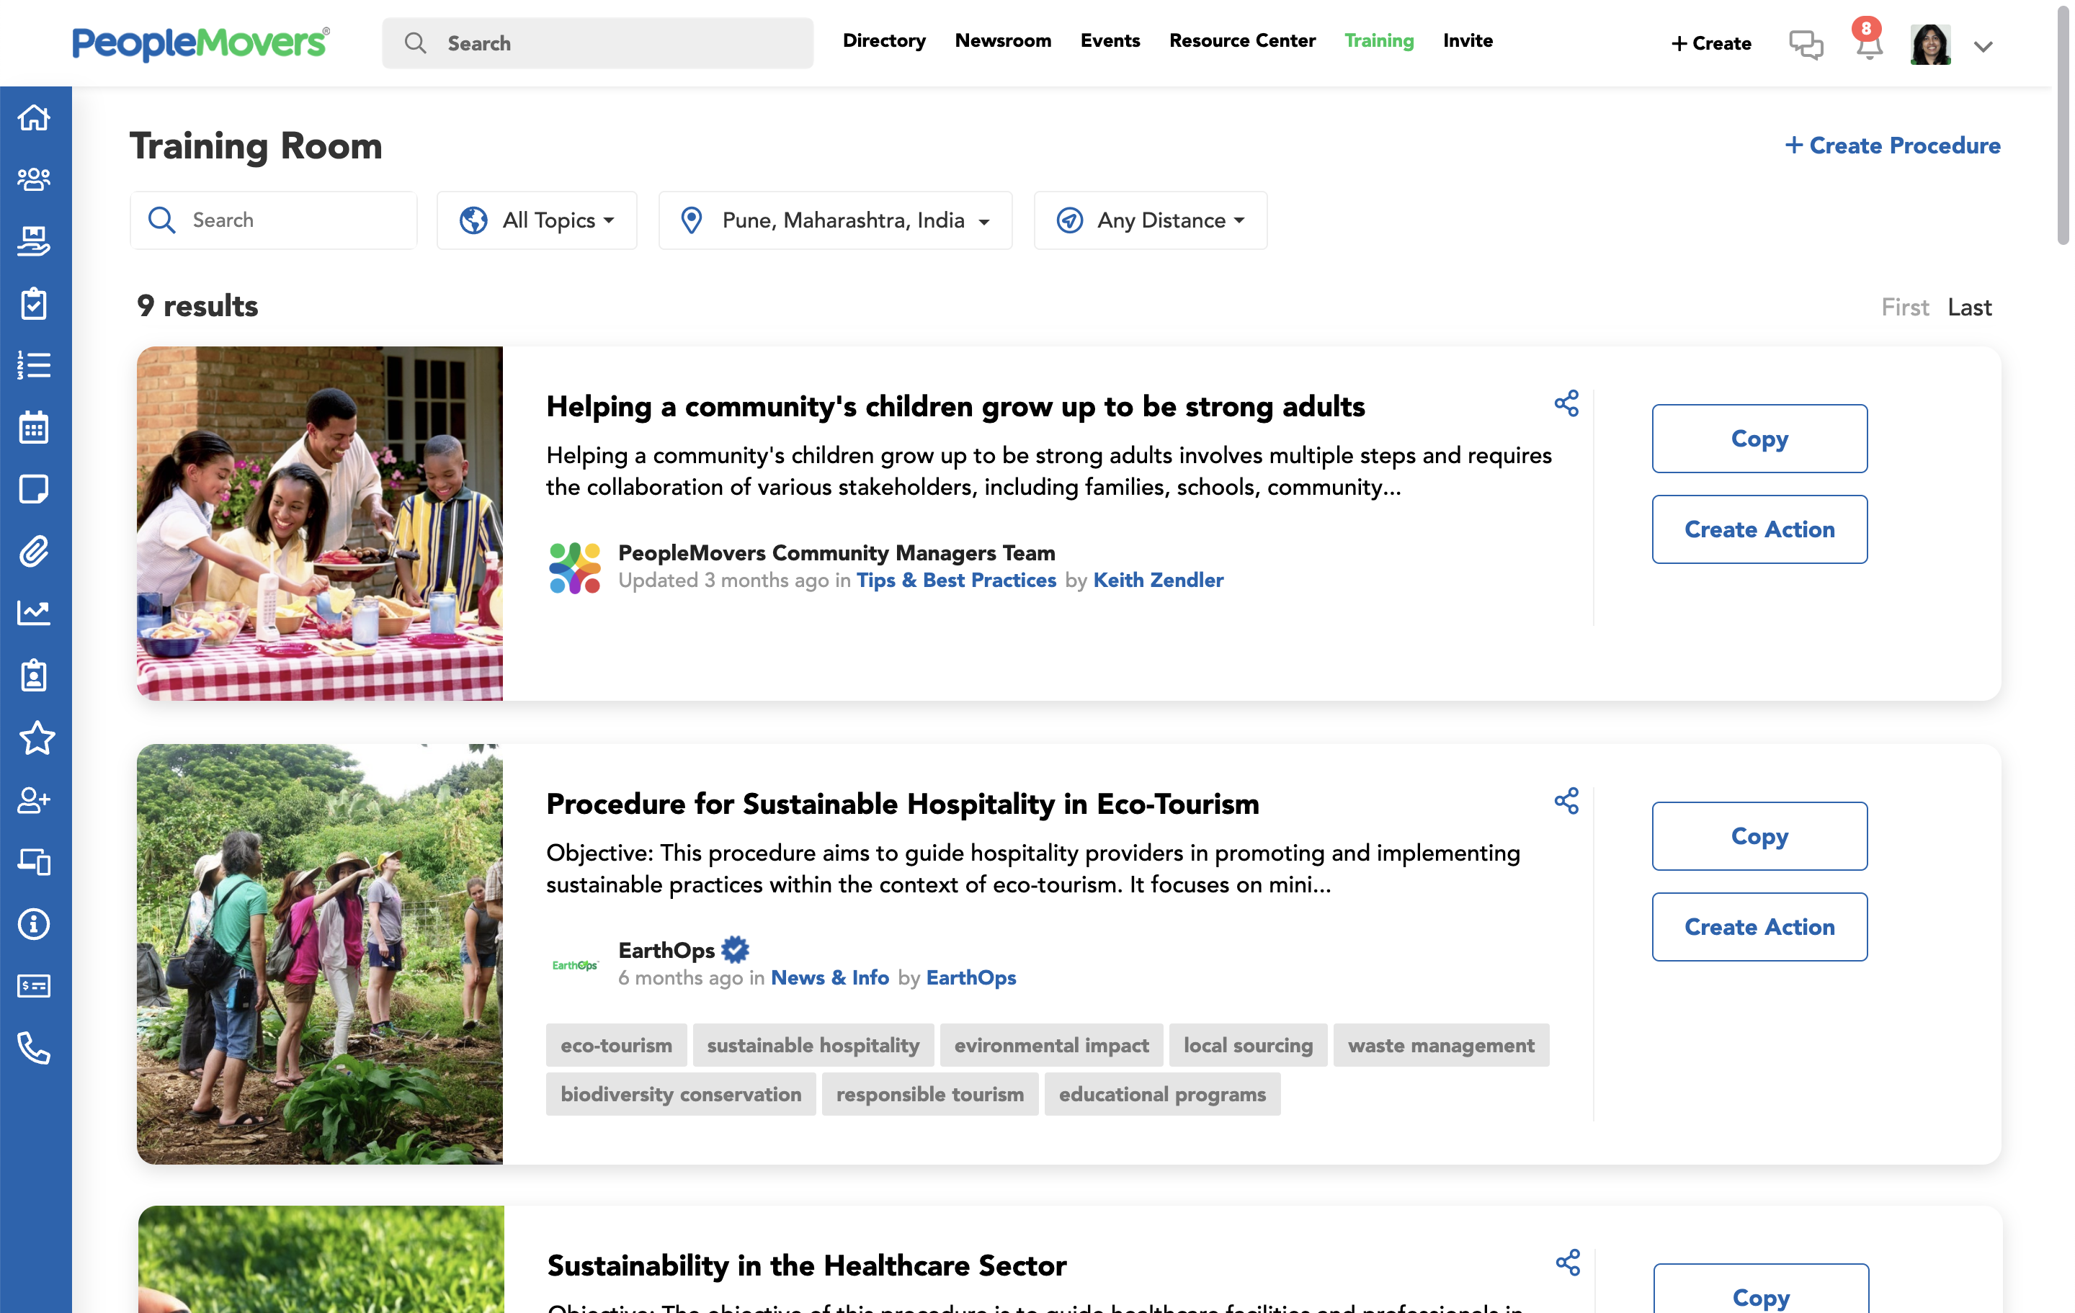
Share procedures and best practices in the Training Room
  The PeopleMovers® Training Room makes it easy to capture, share, and scale your best practices across organizations, communities, and continents.
  Create and document procedures – from simple instructions to full operational playbooks.
  Distribute instantly – to members, volunteers, partners, and stakeholders.
  Turn procedures into actions – assign tasks directly from training materials for real-world execution.

Slide 10
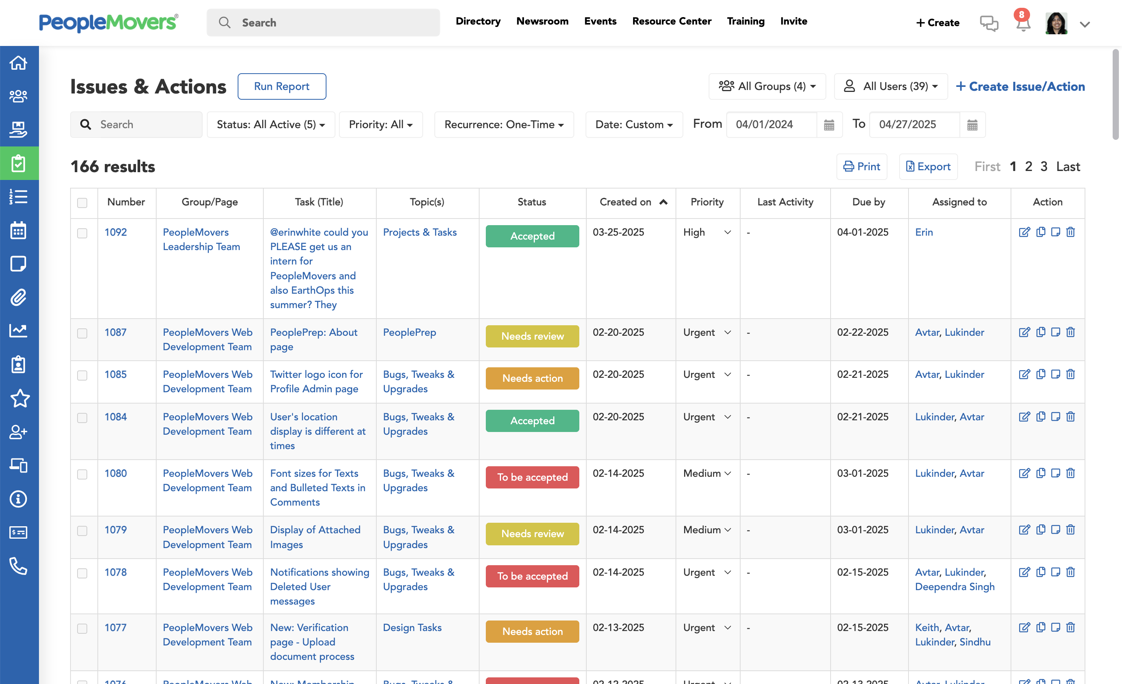
Drive progress by coordinating member and stakeholder Actions
  PeopleMovers® is more than
  a network — it’s a global operating system to organize, assign, and complete real-world actions.
  Create, assign, and track Actions for members, volunteers, teams, or partners.
  Get notified in real time as tasks are completed and progress is made.
  Capture data automatically to measure impact and accelerate success.

Slide 11
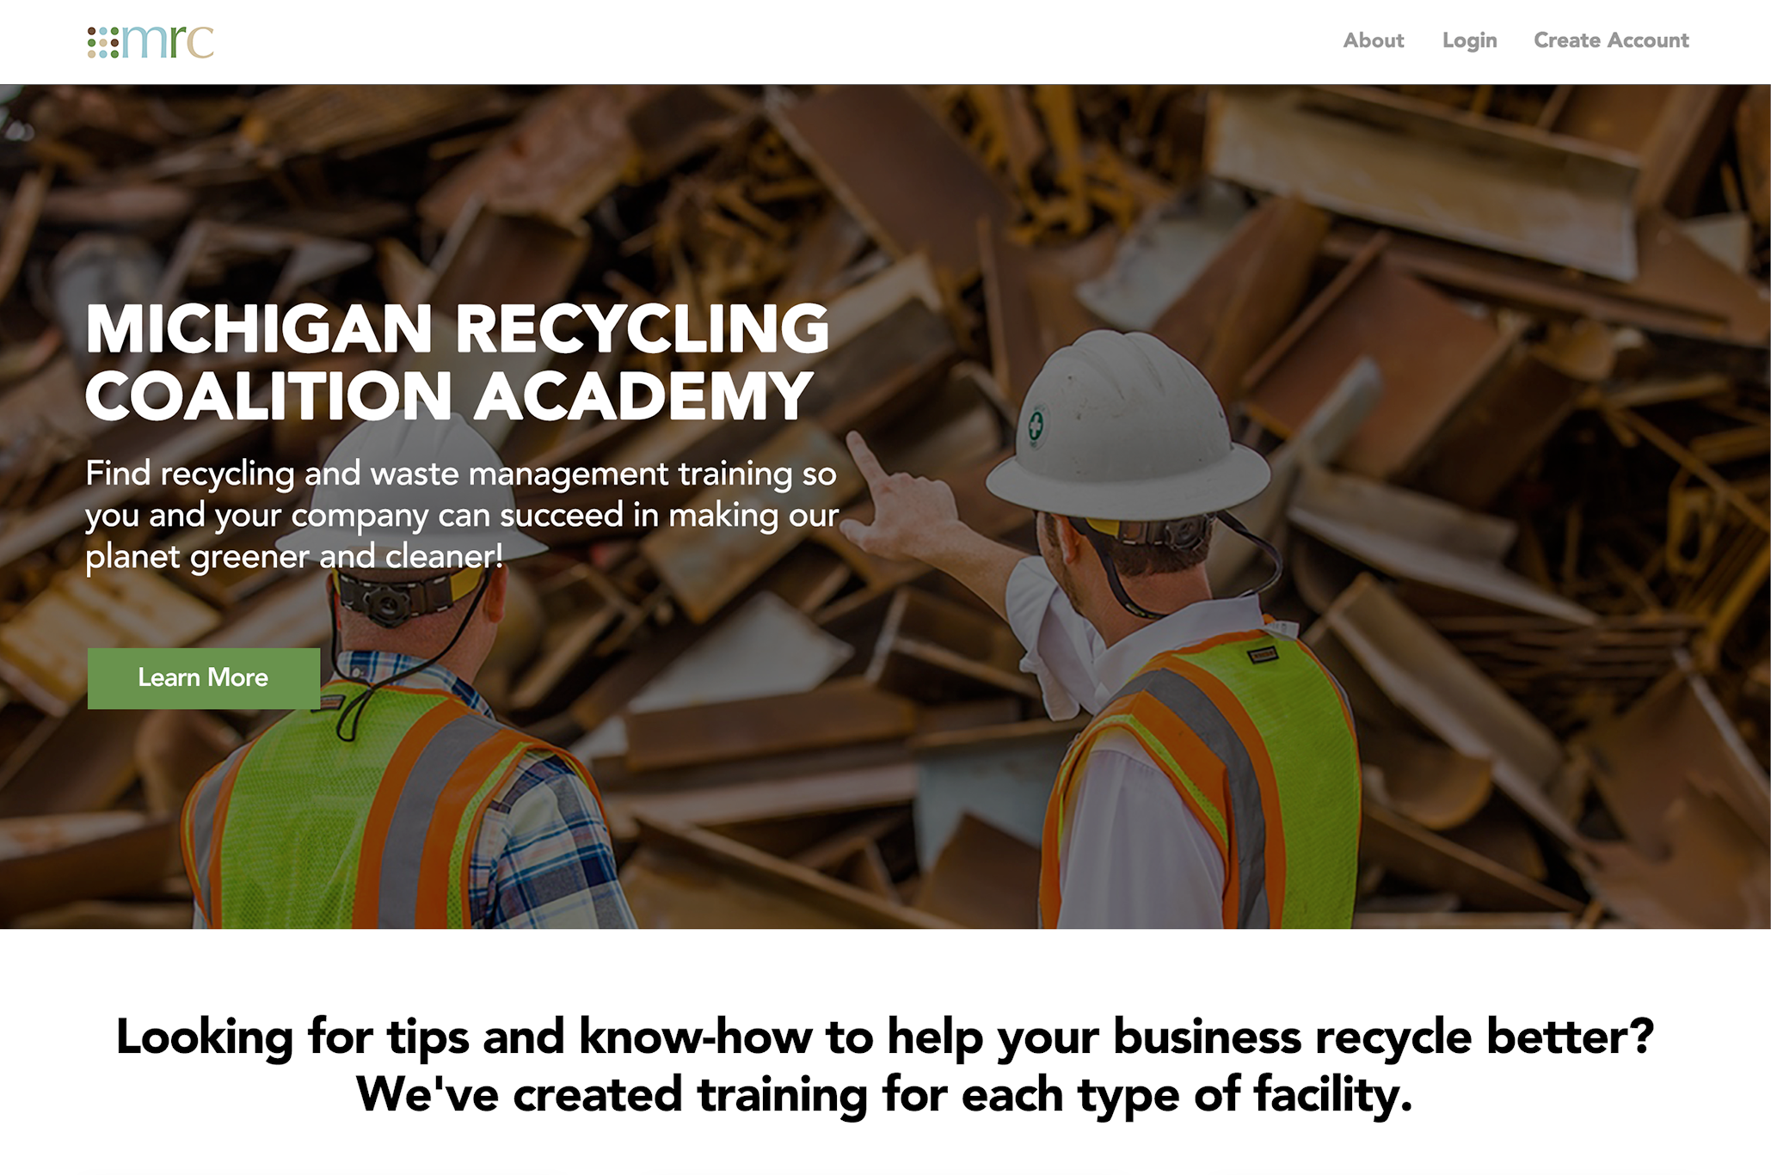
Create branded solutions for organizations and initiatives
  PeopleMovers® can be fully customized to power your mission while connecting to a global network.
  Custom Networks – Brand your own portal with your logo, messaging, and structure.
  Private or Public Access – Control visibility for members, stakeholders, or the public.
  Dedicated Newsroom, Resource Center, and Training Rooms – Share updates, post needs, and best practices tied to your goals.
  Integrated Actions and Reporting – Assign tasks, track completions, and measure real impact.
  Custom PeoplePoints® Rewards – Incentivize engagement inside your own programs.

Slide 12
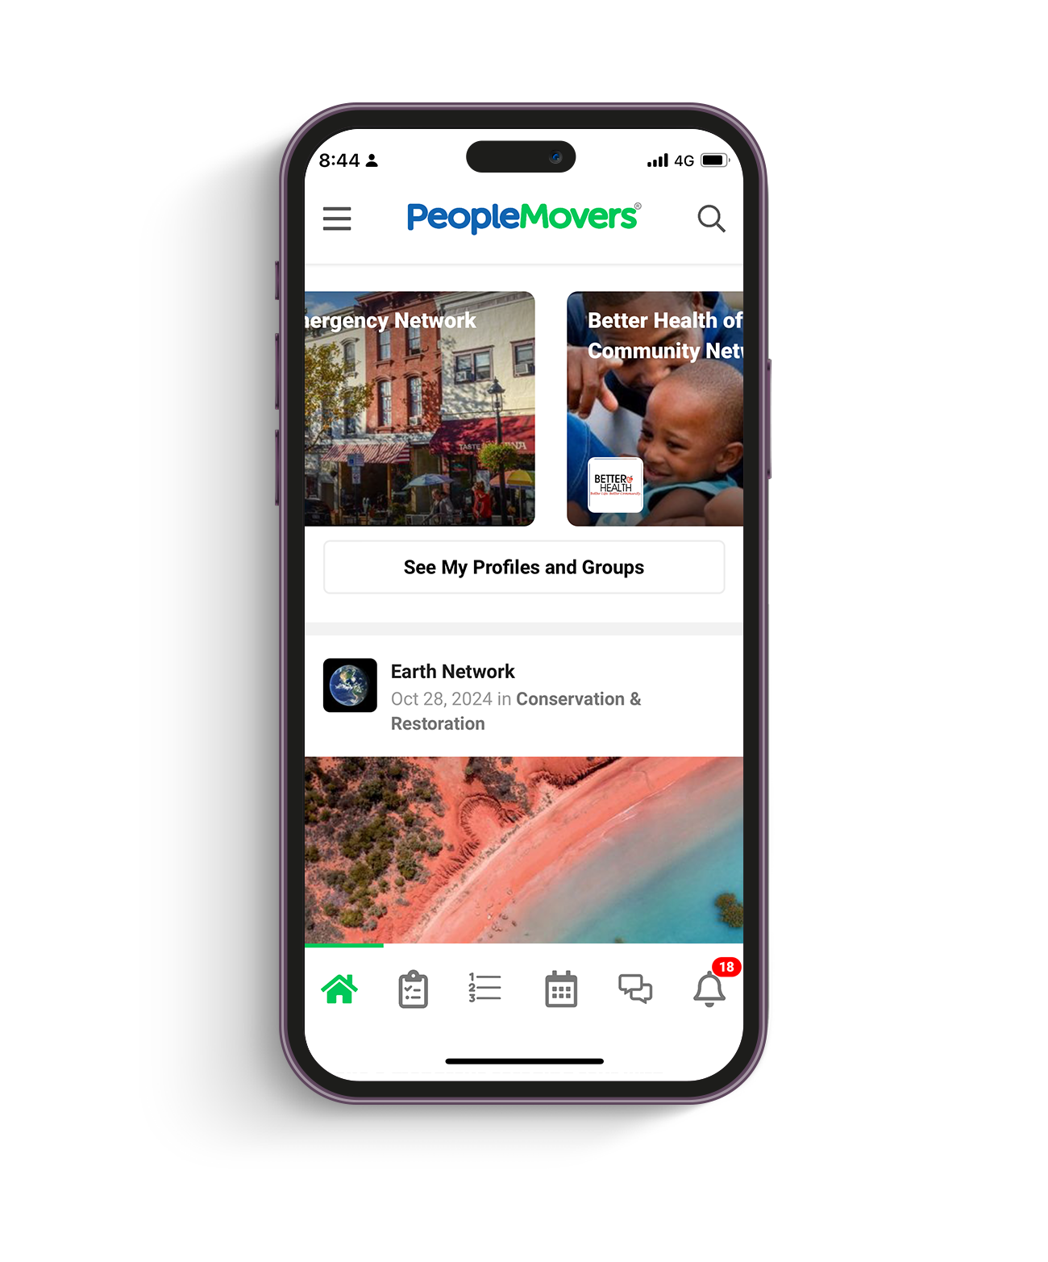




Incentivize action and engagement with PeoplePoints® Rewards
1. Your city or organization buys or receives points to incentivize targeted actions
2. Citizens and members earn points as they complete online and offline activities
4. Businesses reuse points for incentives or donate back to cities & organizations
3. Users redeem points for rewards from brands and local businesses

Slide 13
PeopleMovers® helps you build relationships for maximum impact
Elected & Career
Governmental Officials
HR & Office Managers
Public Relations &
Communications Professionals
School Districts & Universities
Hospitals & Health Care
Companies
Building Owners & Property Management Companies
Health Care Professionals
Houses of Worship & Clergy
Corporate Governmental
Relations & Executives
Foundation, Nonprofit
& Grassroots Leaders
Small Business Owners & Entrepreneurs
Engaged Citizens

Slide 14
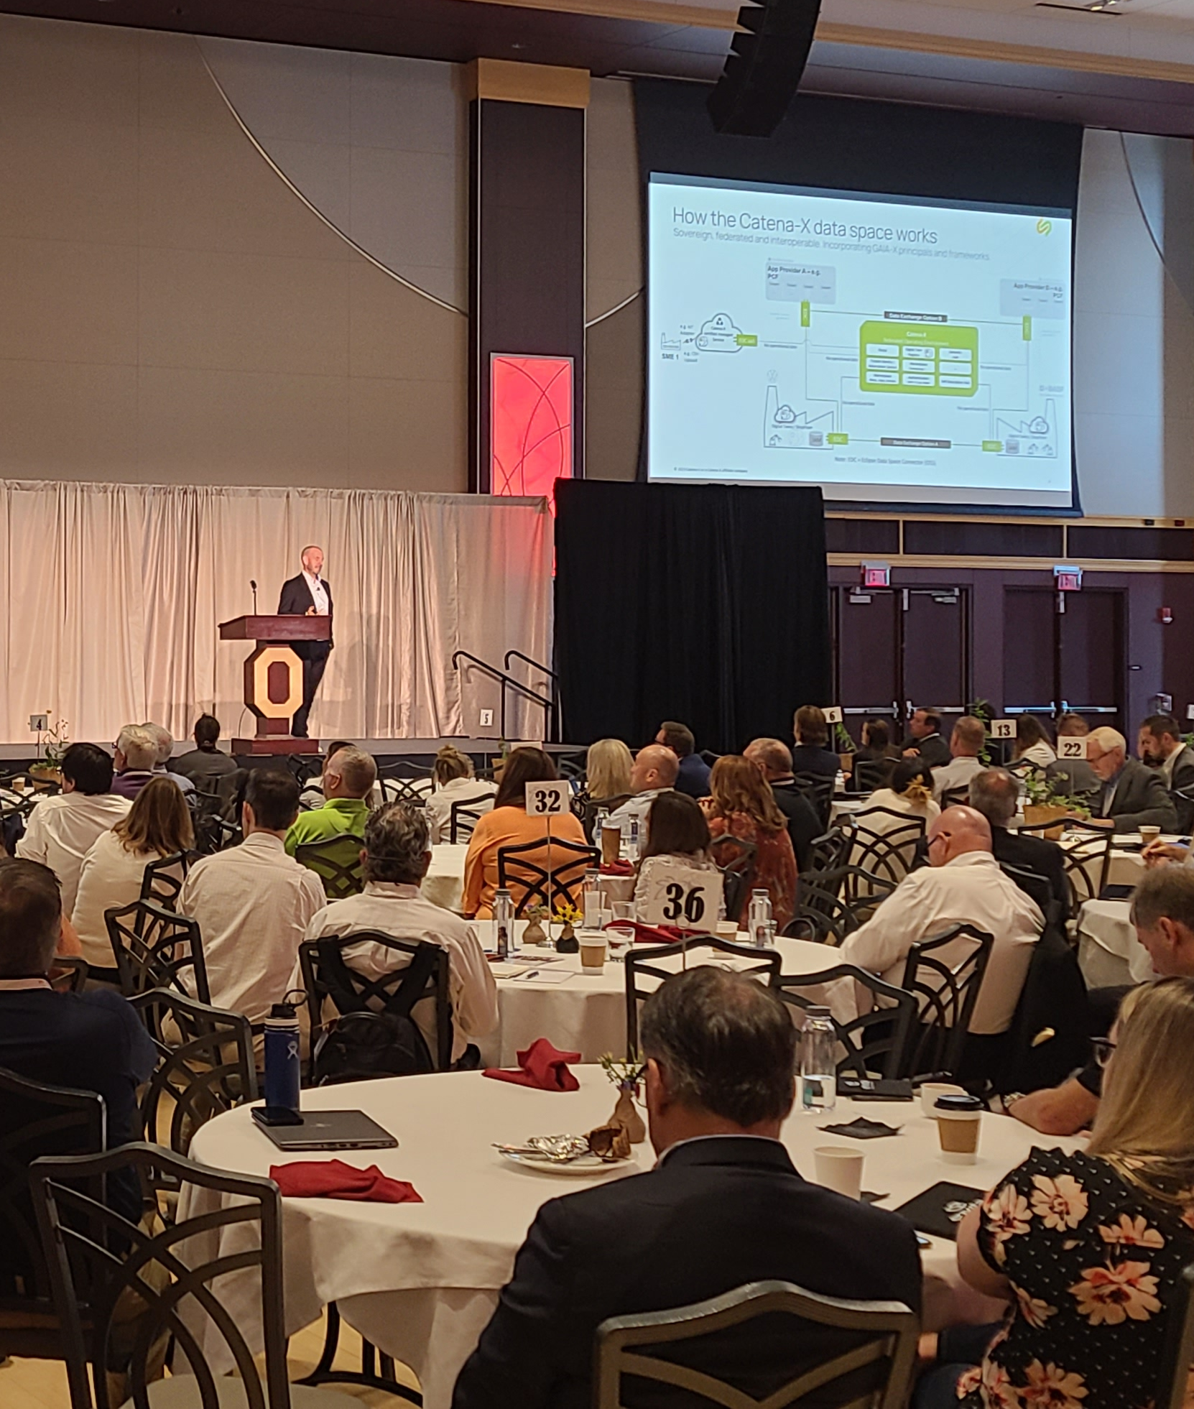
Who uses PeopleMovers®
  PeopleMovers® is designed for leaders and changemakers who are building stronger communities, organizations, and a better world.
  Community Builders – Leaders working to mobilize people, share knowledge, and inspire action locally and globally.
  Organizational Leaders – Executives, managers, and team leads from companies, nonprofits, governments, and associations who want a better way to coordinate projects, initiatives, and stakeholder engagement.
  Sustainability and Impact Teams – Groups driving environmental,
  social, and economic change, using PeopleMovers to organize efforts, assign actions, and measure real-world progress.
  Government Innovators – Officials and agencies aiming to bridge
  public-private partnerships, foster civic participation, and meet the challenges of today’s world.
  Emergency Planners and First Responders – Teams who need a
  reliable network to plan, prepare, and stay connected before, during,
  and after critical events.

Slide 15
How it works
Sign up
for FREE
Organization
Verification
Premium Functionality
Sponsored
Content
PeoplePoints® Rewards
Easy for companies, cities, organizations & individuals to join
Agencies, companies, and organizations upgrade to Pro ($79/month+) to be Verified so they can create public posts
Branded networks, manage multiple entities, manage services, and more starting at $449/month
Verified entities pay $50+ CPM to promote content across news feeds and on emailers to network leaders
Buy points
at $50+ CPM
to fund incentives for training & participation and to sponsor posts

Slide 16


Why choose PeopleMovers®
Global reach – The world of community & global
development leaders and organizations at your fingertips
Affordable – No big capital outlays
Easy – Perfect for governments, companies, and
organizations with small staffs
Comprehensive – Covers the full scope of development concerns and activities
User-Friendly – Coordinate between multiple partners
and entities at all levels of sophistication
Interconnectable – Can seamlessly connect with your
outreach and project management software tools
Support – Our team can help you get started, create programs, and even manage the day-to-day activities of your initiatives.

Slide 17

Be a leader in solving our world’s challenges.
Initiatives will be EASIER to implement and manage
You’ll have a DIRECT channel to broadcast information to key leaders locally & globally
Organizational & community stakeholder sustainability & resiliency will INCREASE
Your reputation as a leader in your industry and community will SPREAD
Strategic partnerships, community relationships, and program impacts will GROW

Slide 18
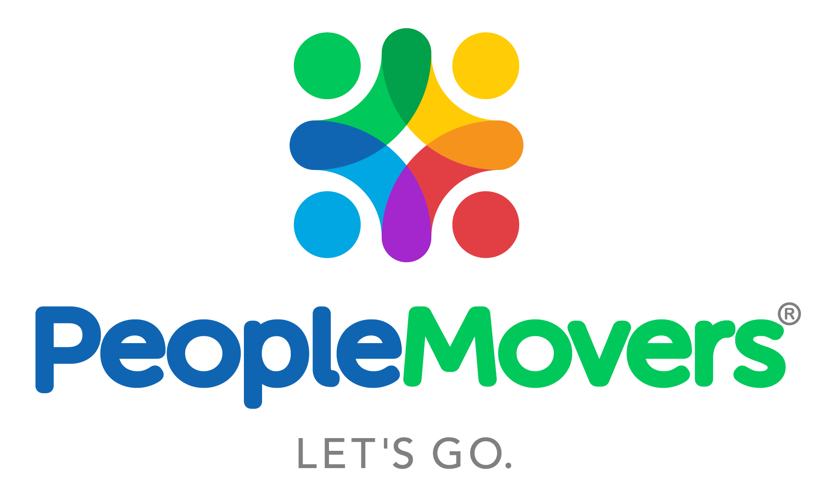

The more we work together, the stronger we become.
peoplemovers.com
© 2025 PeopleMovers.com, Inc. All Rights Reserved.

